Slide 1
Mall Customer Segmentation
In recent years, malls in Singapore are facing a tough challenge in trying to remain relevant. How can mall owners rise up to the challenge?
Oh Tien Cheng (2012072)

Slide 2
Problem Understanding
Customer Segmentation
Using clustering, we can group our customer base
We can then identify the best customer base to target, and devise strategies to attract them
We can also analyse the different customer segments, and see which groups have the potential to be turned into our target audience.

Slide 3
Dataset Details
Attribute | Data Type | Notes
Gender | String | Gender could affect the type of items/services purchased in the mall
Age | Integer | Age can determine the stage of life of a person, affecting their spending power and habits
Annual Income (k$) | Float | Gives an idea of the potential spending power of the customer
Spending Score (1-100) | Integer | Someone with a high spending score is desirable, as it means they contribute a significant amount of the revenue of the stores inside the mall
Customer data collected by the mall
Gender
Age
Annual Income in Thousand Dollars
Spending Score
200 Rows of Data
No missing values
Gender attribute is misspelled as Genre

Slide 4
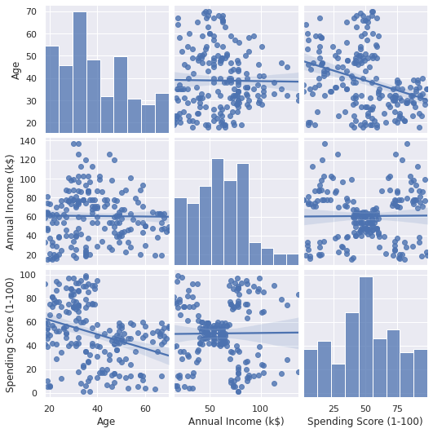
Exploratory Data Analysis
Age
Age distribution is positively skewed, with no outliers
Most customers are middle aged
Annual Income
Annual Income is negatively skewed, with 50% of customers earning >$61k annually
This means our customer base mostly have high spending potential
Spending Score
Distribution is slightly positively skewed, with no outliers.

Slide 5
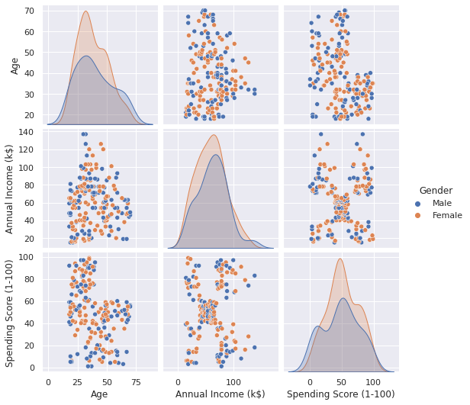
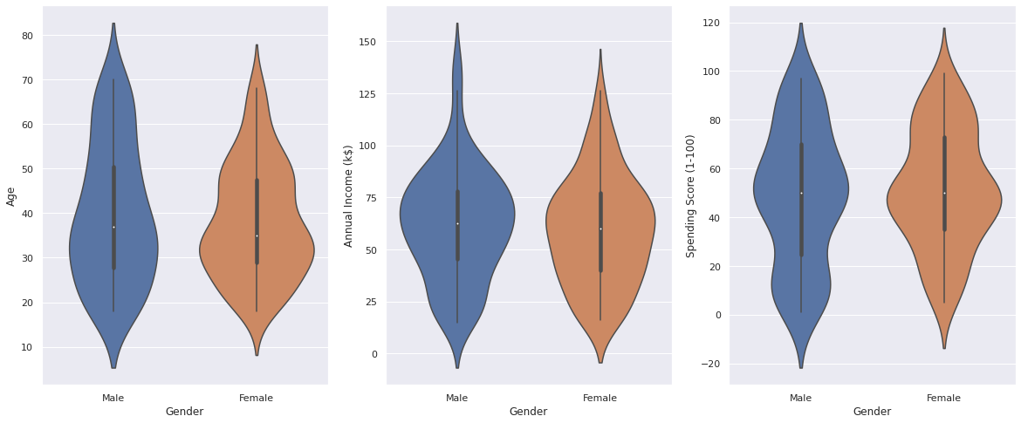
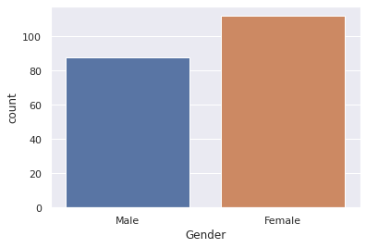
Exploratory Data Analysis
Gender
56% of Customers are Female
Male and Female customers do not appear to have significantly different distributions and do not form distinct clusters
Two sample t-test on the sample means show no evidence for a significant difference (significance level of 0.05, equal variances)

Slide 6
Data Preprocessing
Gender feature was dropped
Decided not to scale the data, given that the features were already on a similar scale

Slide 7
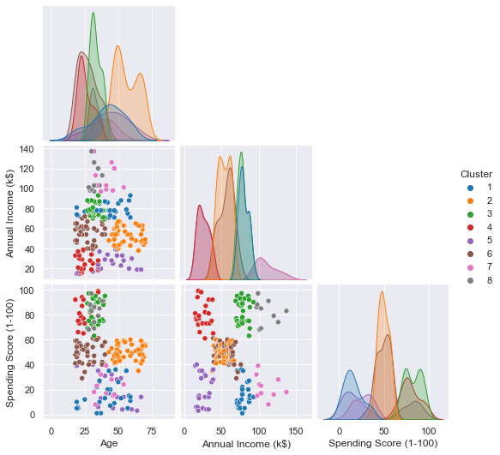
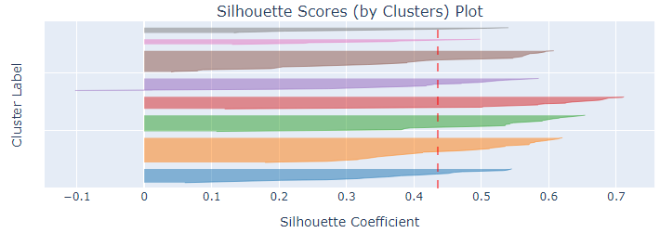
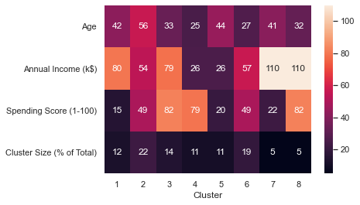
K-Means Clustering
By default, K-Means segments customers into 8 clusters
Clusters formed vary in size: Cluster 7 and 8 are very small
Cluster 7 similar to Cluster 1, with customers in Cluster 7 having a higher income than those in 1
Similarly, Cluster 8 is similar to Cluster 3, with Cluster 8 customers being more wealthy than those in 3

Slide 8
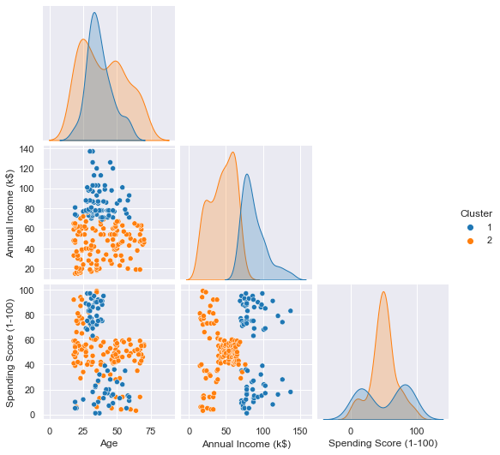
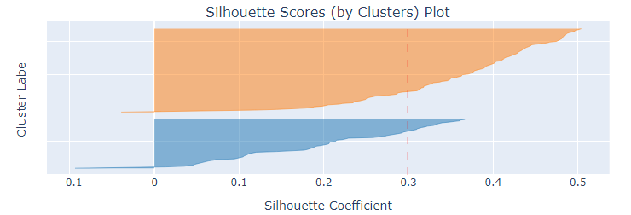
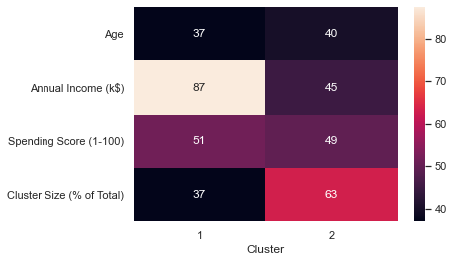
Hierarchical Clustering
By default, Hierarchical Clustering separates the data into two clusters
Customers are segmented by their annual income.
Cluster 1: High Income Earners
Cluster 2: Low Income Earners
The resulting clustering is suboptimal as the clusters are poorly defined, and only make use of a single feature

Slide 9
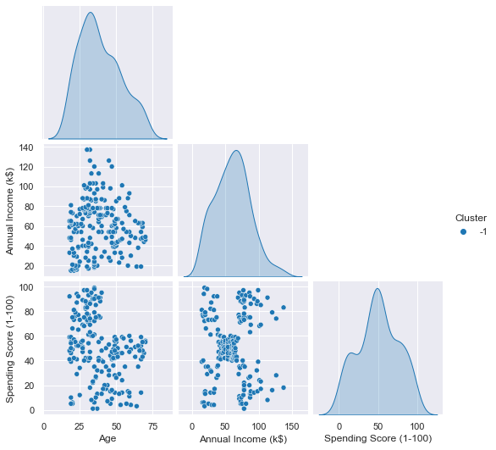
DBSCAN
By default, data is unsuitable for DBSCAN
All points are regarded as noise by the algorithm, suggesting the model requires more tuning

Slide 10
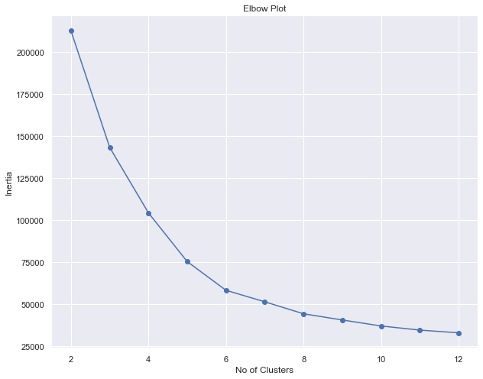
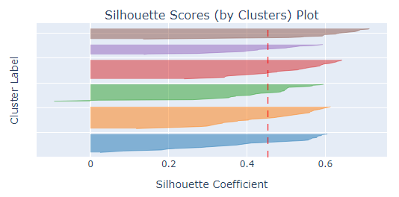
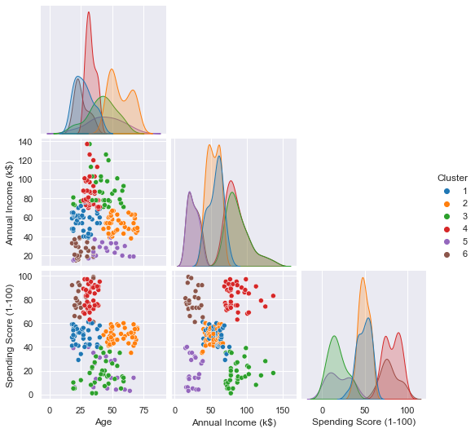
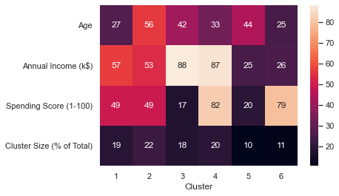
Model Improvement: K-Means
K-Means
Used elbow plot, and silhouette score to determine optimal number of clusters: k = 6
Increased the number of initializations to find better initial centroids
Ultimately selected as the final clustering used

Slide 11
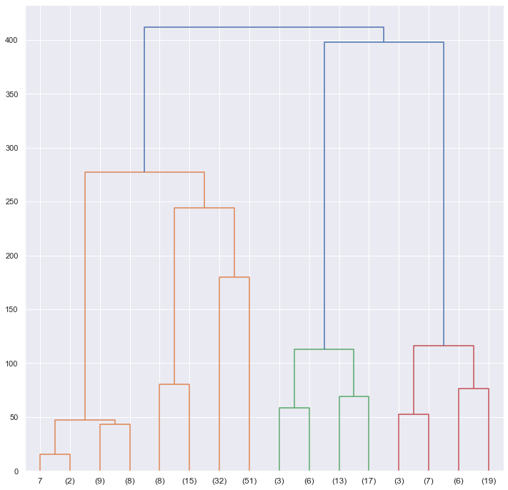
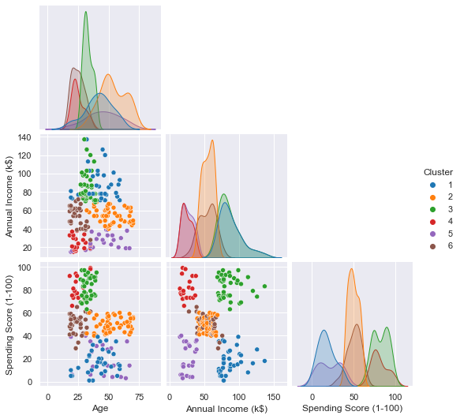
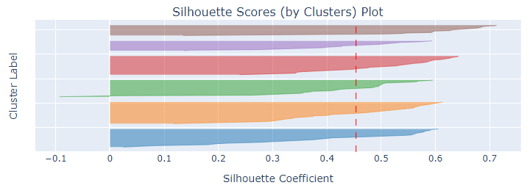
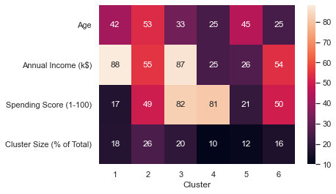
Model Improvement: Hierarchical Clustering
Plotted a dendrogram and analysed silhouette score to get optimal number of clusters: 6
Clusters formed appear to be slightly less well defined on average than K-Means

Slide 12
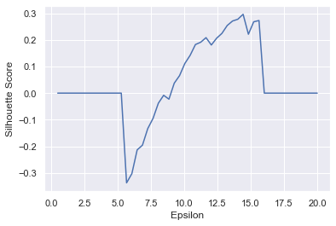
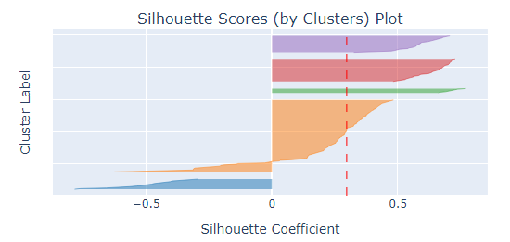
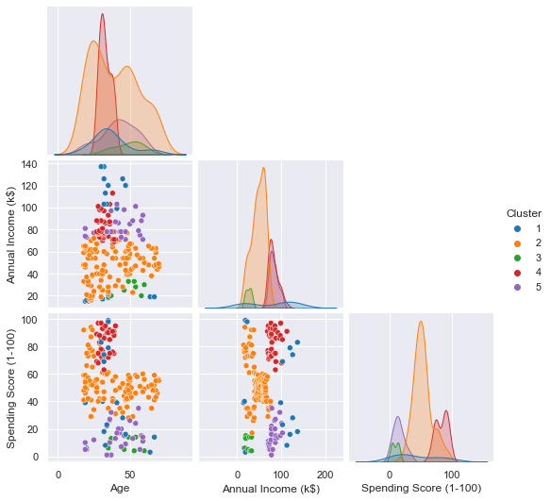
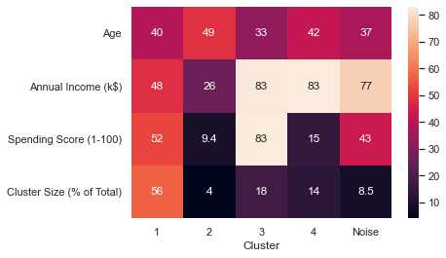
Model Improvement: DBSCAN
Min Samples: Set as 2 * Dimensions → 6
Search was conducted through values of epsilon, finding eps = 14.42 as the best option
DBSCAN detected 4 clusters (excluding noise)
Clusters split customers into four main segments:
Typical Customers
Rich Customers with High Spending
Rich Customers with Low Spending
Poor Customers

Slide 13

Interpretation of Final Clustering (K-Means)
Segment 1: Low Income Customers This segment consists of customers who are more frugal, possibly due to a poor financial situation. This means they are less likely to be persuaded to spend more in the mall, due to their lack of means.
Segment 2: Typical Old Customers The largest segment. While this segment is similar to segment 5, their old age means they are more likely to continue to shop in the mall due to less proficiency with technology and more conservative mindset. Hence, they are easier to keep around. Their older age means their incomes are less likely to increase.
Segment 3: Frugal Professionals This segment consists of middle aged high income earners who do not spend a lot in the mall. This indicates that they are picky about what they spend money on. This group has a high potential if they can be converted to loyal customers of the mall.

Slide 14
Interpretation of Final Clustering
Segment 4: Young and Irresponsible This segment consists of young and low income customers who are big spenders in the mall. Their high spending score suggests they are loyal customers, but they lack potential for further spending due to their low incomes.
Segment 5: Typical Young Customers This segment represents the average young adult shopper. Their younger ages mean they are more savvy and hence more likely to increasingly turn towards online retail.
Segment 6: Professionals This is an attractive segment of young to middle aged customers who are not only wealthy, but are also big spenders. Their high spending score indicates they are already loyal customers.

Slide 15
Conclusion
Recommendations to Owner
Target Segment: Segment 3
Why?
High spending power and potential for growth
High incomes mean less reason to turn towards e-commerce for cheaper deals
Large segment
Not yet loyal shoppers, so greater potential returns than targeting already loyal customers
How?
More research into this target segment to do targeted marketing
Offer more unique experiences: e.g. Integrate tech for better convenience, family activities like waterparks

